Slide 1
PLAYING THE CARDS YOU’VE BEEN DEALT
MOLLY BARRETT
Owner, Maggie & Moe’s Poplar Flowers & Decor,
Co-Founder, PS We Love You Fund

Slide 2
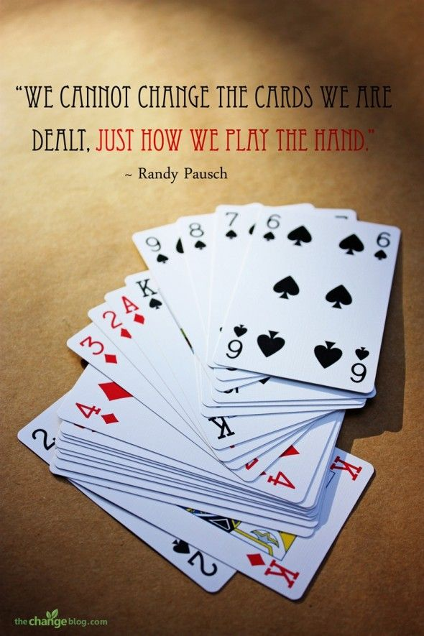

Slide 3
Overview
Personal Background
Our Cards
To Play or Fold
Change of Game
Q&A

Slide 4
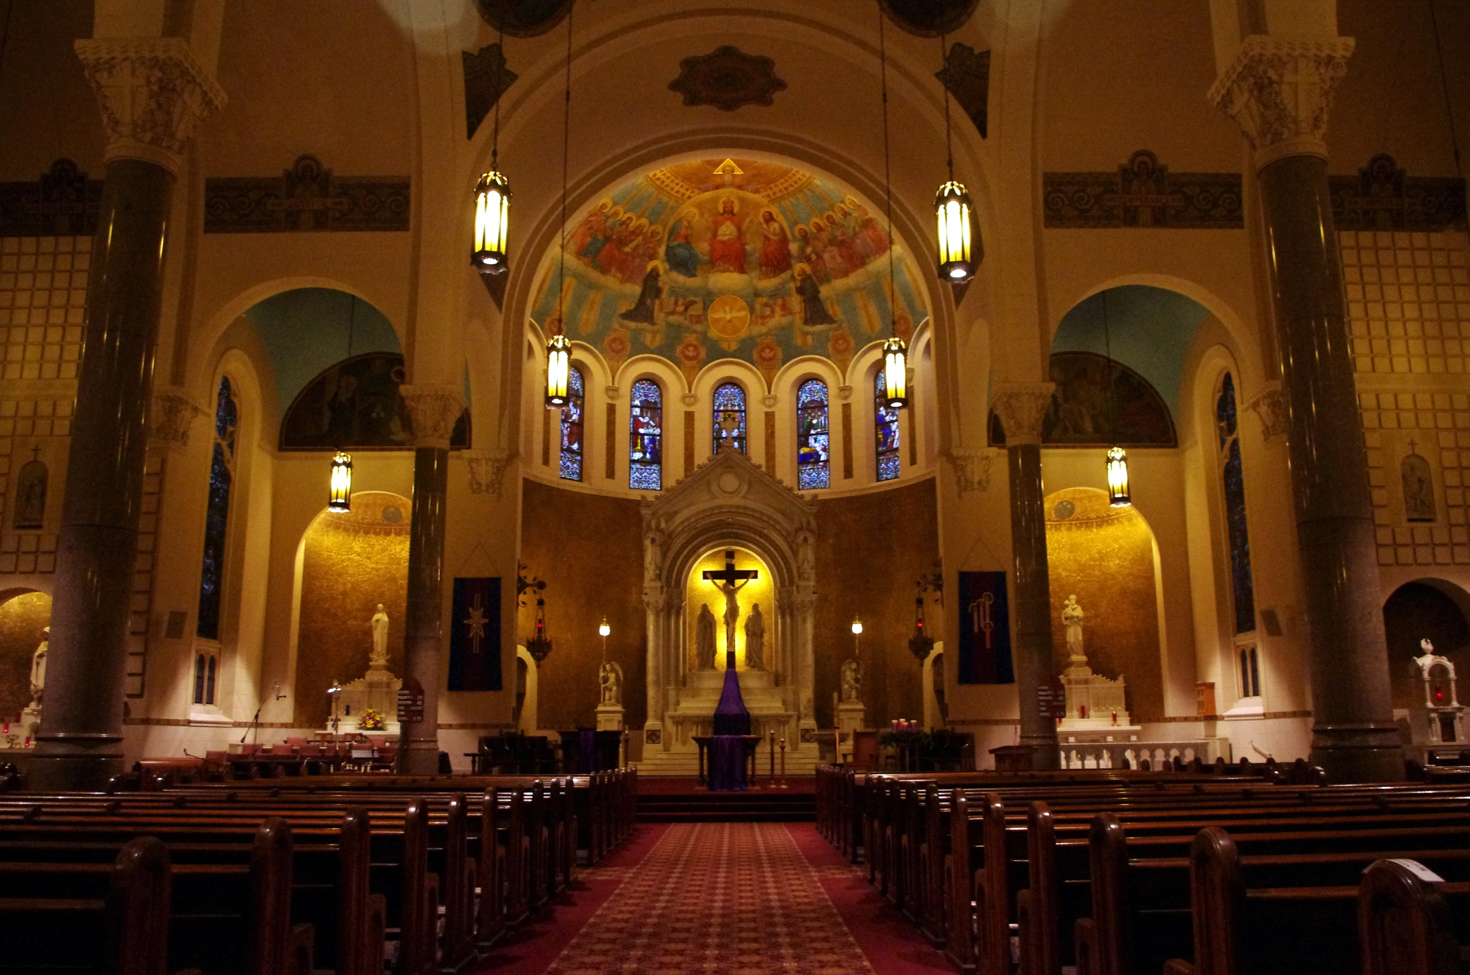
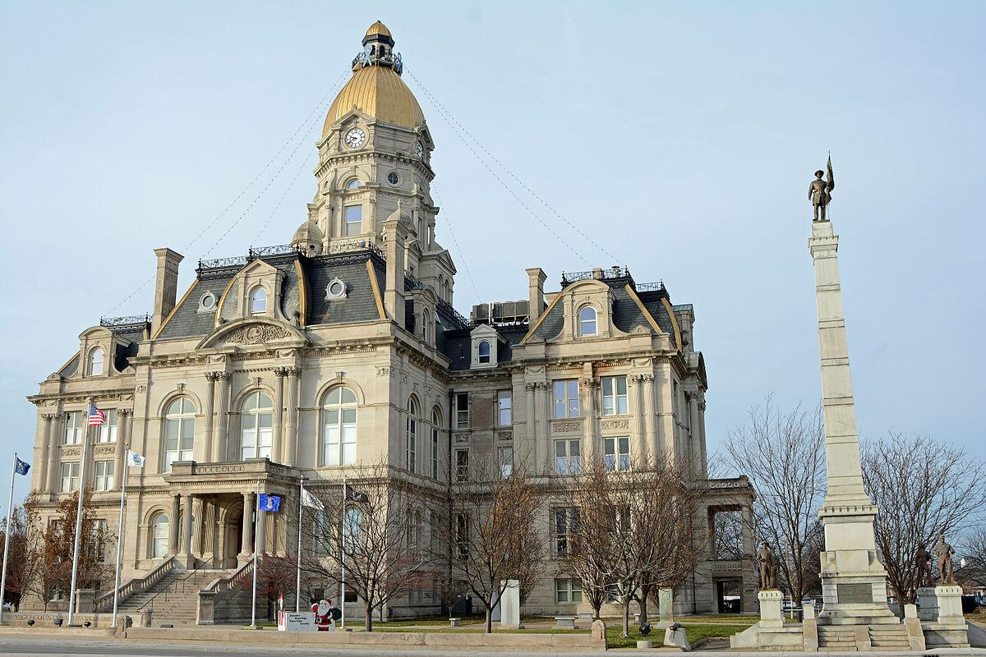
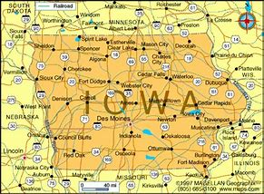
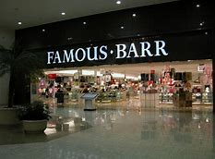
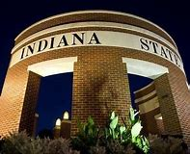
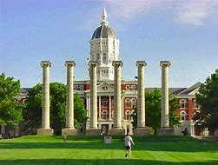
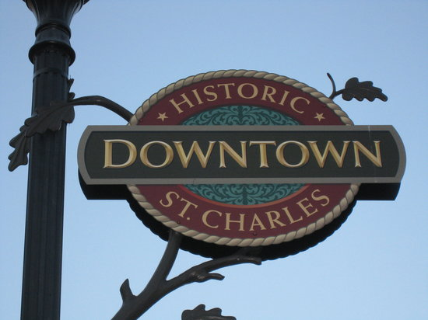
A Little About Us

Slide 5
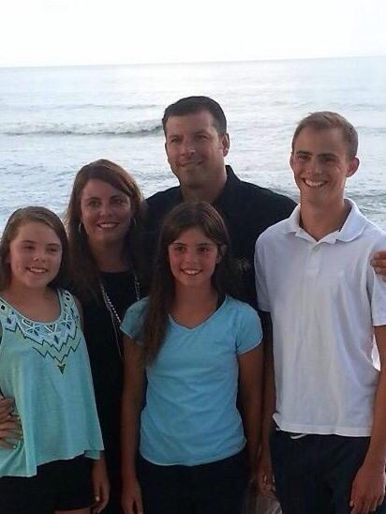
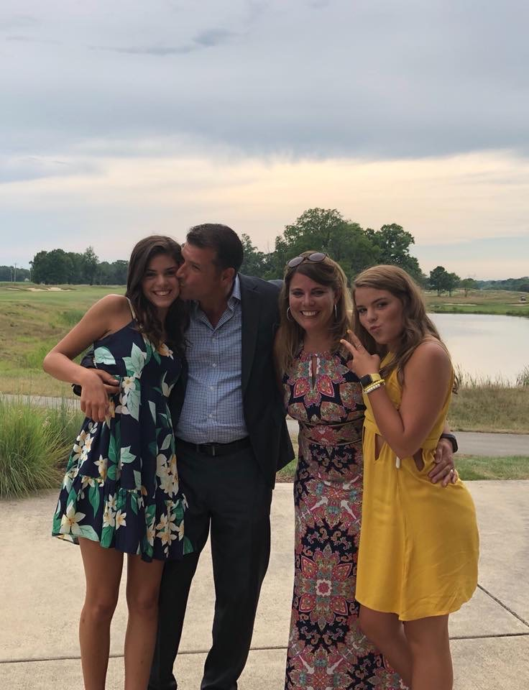
Changes...

Slide 6
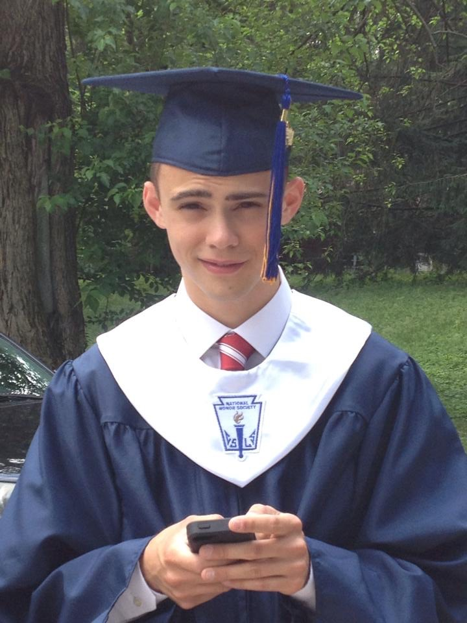
The Deal
Our Cards
July 2009
Life changing diagnosis
Ewing's Sarcoma
10 months at Riley Hospital
Our Play
Maintain normalcy
December 2014
2nd diagnosis – Osteosarcoma
15 months of treatment
Our Play
Maintain normalcy

Slide 7
Play or Fold

Slide 8
PS We Love You Fund
Established to provide precision genomics testing for children with reoccurrence or highly aggressive cancers.
Raised over $325,000 since 2016.
Tackle Childhood Cancer Campaign
3 Colleges/Universities, x high schools, 1 Middle School, 14 Elementary School
One Day St. Patrick’s Day on-line fundraiser
Christmas in the Park

Slide 9
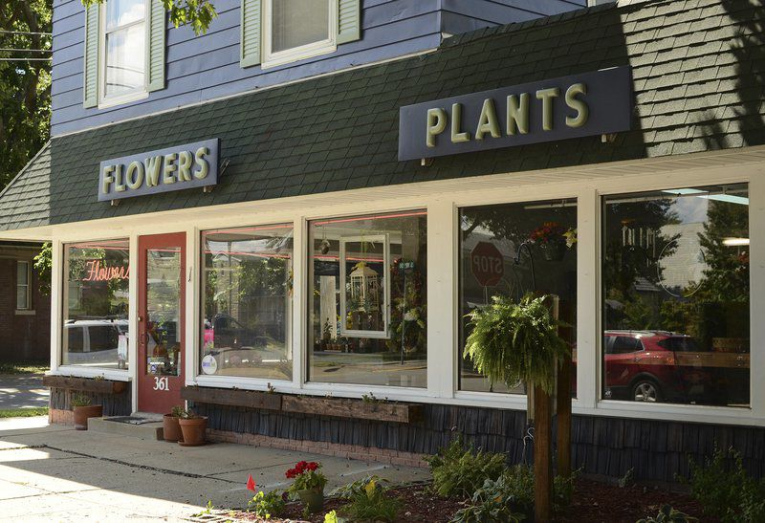
Change of Game
Priority ‘realignment’
Are we using our experiences and talents?

Slide 10
Q & A

